Slide 1
Detection and Prevention of Covid-19
Group Members:
Aayush Surawar - 11910859
Shreyas Mandaokar - 11910909
Kshitij Patil – 11910706
Sarvesh Sontakke - 11910862
Shreyas Talwekar - 11910658

Slide 2
Problem Statement
Novel corona virus or covid-19 is an ongoing pandemic caused by severe acute respiratory syndrome. Test for covid-19 takes few hours to few days depending upon which test you take. If it is detected little earlier then the infected person can take proper precautions and can help from spreading corona virus.

Slide 3
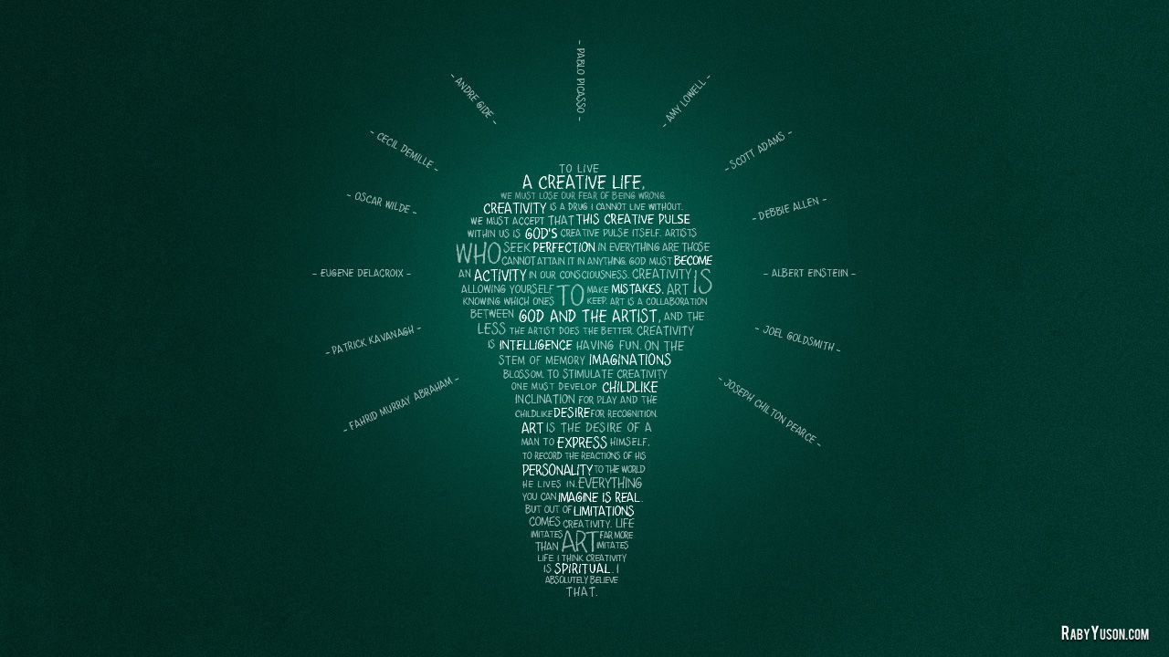


Objectives:
Developing a website which will accept image of the chest X-ray from user and give the result if the user is normal or infected by pneumonia or covid-19.
Provide user friendly interface with useful information and precautions.
Create a CNN model for prediction.
Provide great accuracy.
Create/Find reliable dataset.

Slide 4






Code Editor
FrontEnd
Visual Studio code
Jupyter Notebook.
HTML
CSS
Tools Used
Back End
DL Tool
Django
Resnet 18

Slide 5
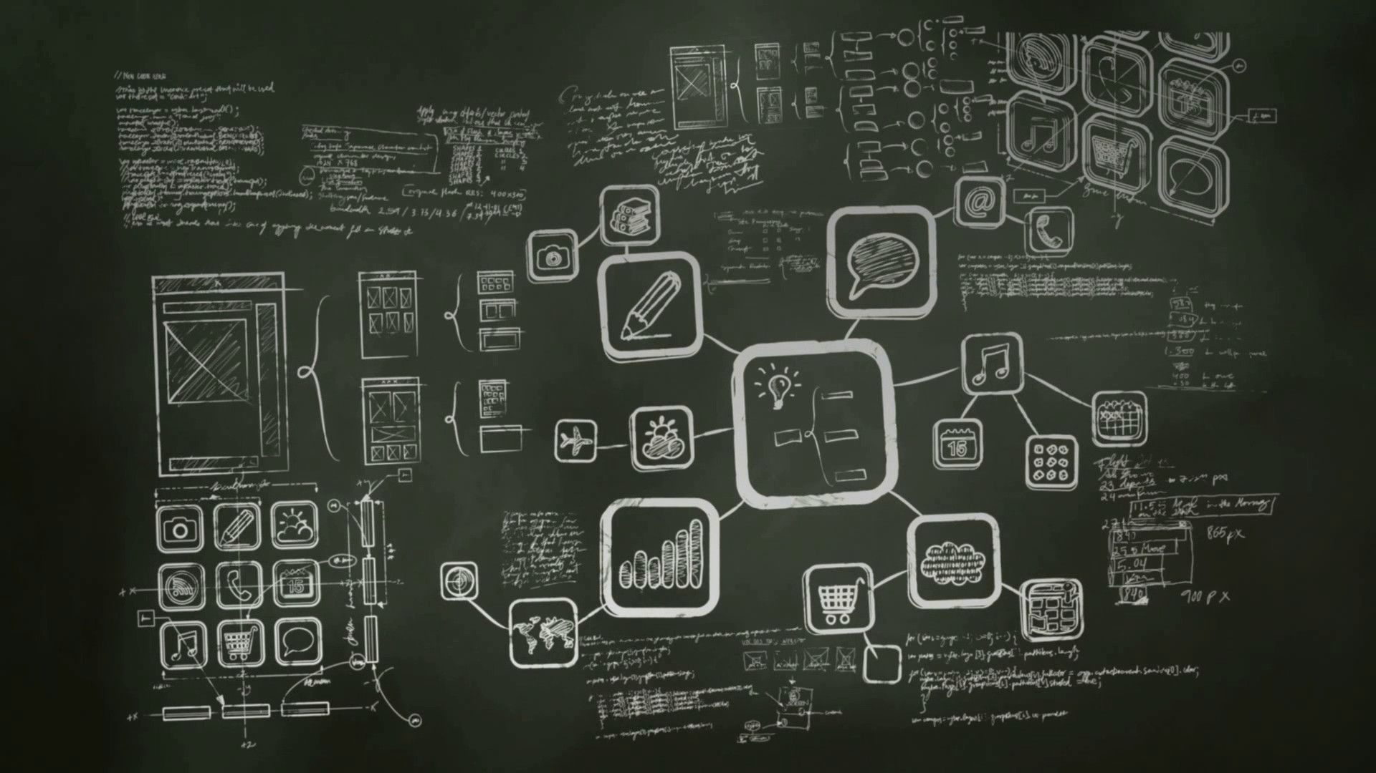

Methodology:
Finding dataset
Data-pre processing and augmentation
Baseline classifier
Convolutional Neural Network
Classification method and optimization
Model Deployment using Django
Making User Friendly Interface

Slide 6


Importing Libraries - shutil , torch , torch Vision
Preparing Training and TestSets
- Creating Directiory for First time from source directiories for 'normal', 'viral', 'covid‘
-making the x-ray image in .png format
-Selecting any 30 random images from dataset
Creating Custom Datasets
- Transforming image
- Taking image from each class and checking for its .png format
- Checking no. of images in dataset
- Avoiding Bouncing and Converting to RGB
Image Transformation
- Resizing image in 224 by 224 px.
- Normalizing training and testing image by mean=[0.485, 0.456, 0.406], std=[0.229, 0.224, 0.225]
Preparing DataLoader
Making Directiores i.e for Training and Testing Containing Covid , Normal and Viral
Batch making ,keeping size 6
Selecting image form batches for Training and Testing

Slide 7

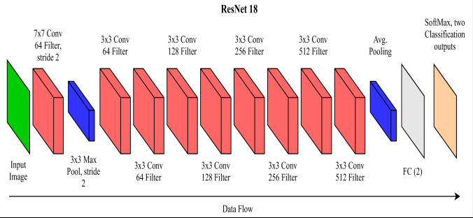
The Model:
ResNet18 is a deep learning model used in computer vision.
It consists of various layers like conv2d, pooling, dropout etc.

Slide 8
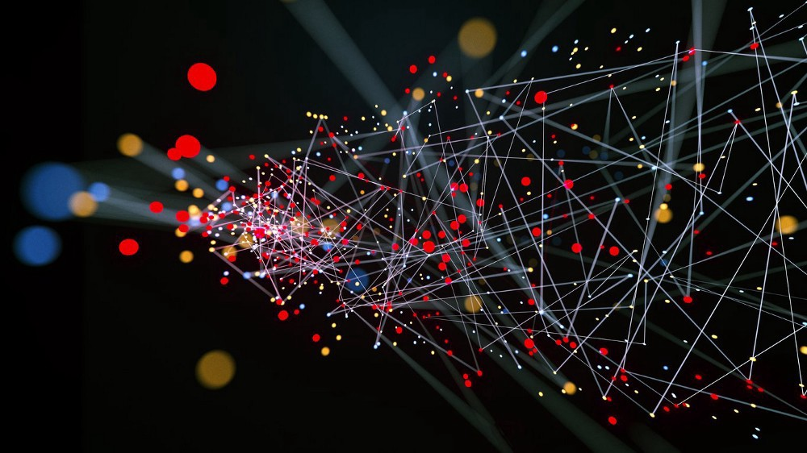
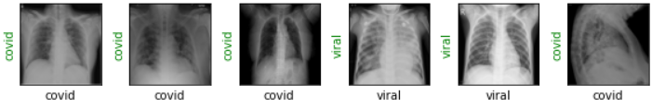
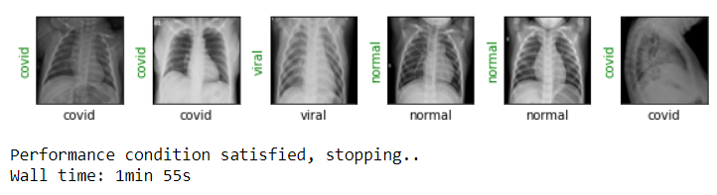
Training Model
The model is trained using the Adam optimizer, CrossEntropy loss function and input and output features.
The input images are put into the model in the form of batches and the model is trained over a definite number of epochs.

Slide 9
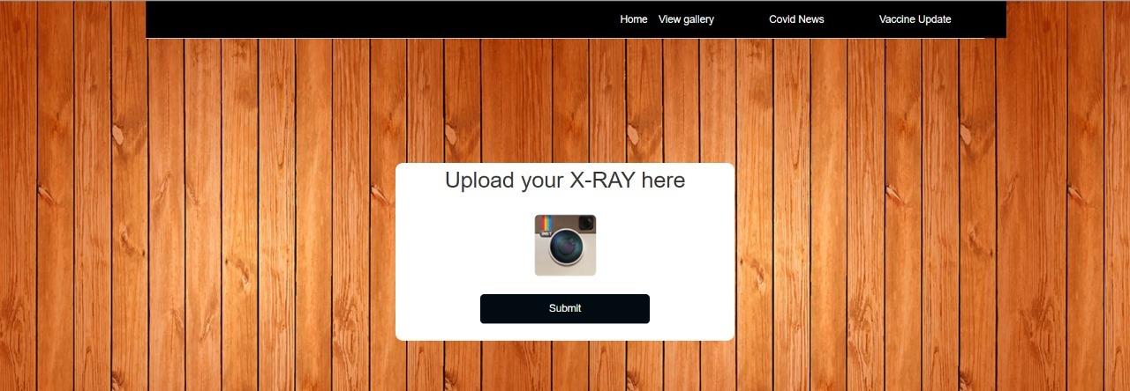
Front-End
The front-end is done with HTML 5 and CSS. It is easier to work with Jupyter Notebook when Django is used.
Some Useful links are also added.

Slide 10

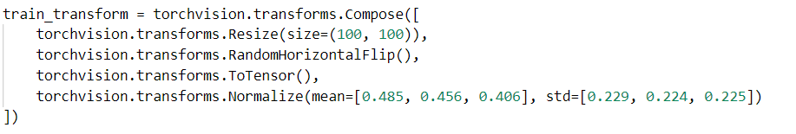
Backend
Pickled file of the deep learning model is loaded in Django using joblib.
Image given by users is fed to the model by applying some transformation.

Slide 11


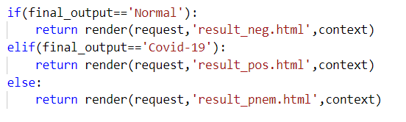

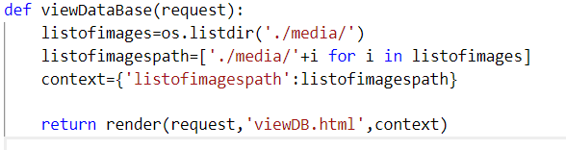
After taking prediction in consideration, redirection from homepage to result page is monitored.
The images that has been given by users has been saved as a database.

Slide 12

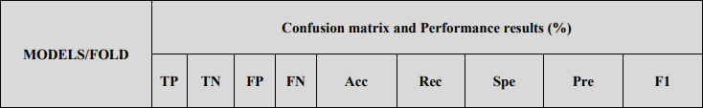
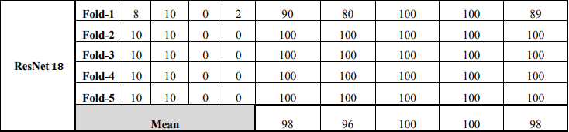
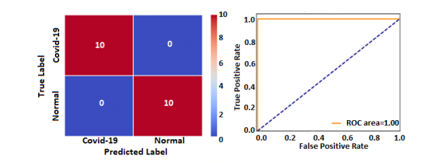
Performance Analysis:
Highest accuracy: 98%
Recall : 96%
AUC(Area under ROC curve): 95.52%
F-measure: 98%
Sensitivity: 94.03%
Specificity: 100%
Precision: 100%
Lowest Fallout: 4.48%
Miss rate: 2.98%
The confusion matrix and ROC plots obtained using pre-trained models for fold-3 results

Slide 13
Advantages:
Our system gives result faster than the physical test, so the person will get alert earlier and will start taking precaution and hence help preventing the infection further.
If people check first using our resource and then decide to go for physical test if the result is positive, then the load on the test centers will reduce considerably.
This will save money of many unnecessary tests and will help test centers to generate reports faster as load will get reduced.

Slide 14
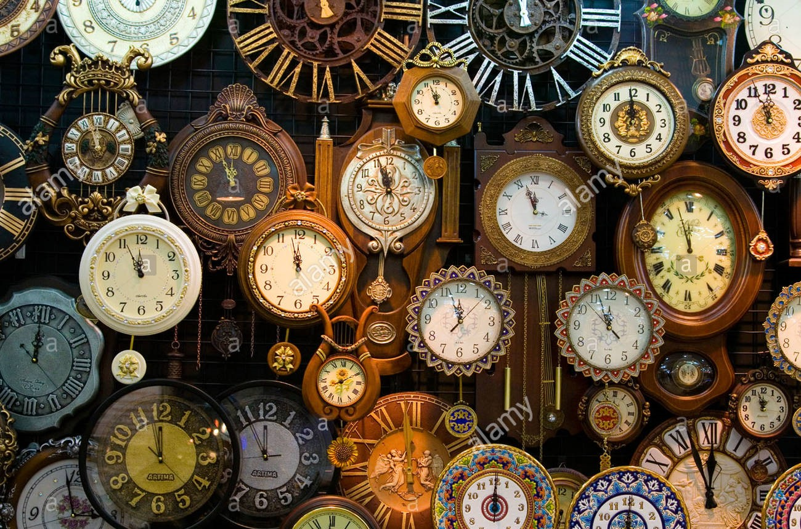
T
I
M
E
P
L
A
N
28th Aug.
Week 1
Study papers and find resources.
Create environment and work on programming.
Week 4
Train dataset
Week 6
Complete the main programming and get the output
Week 8
Week 10
Searching for platforms to deploy and get started with it.
Complete basic functioning of webiste
Week 13
20th Dec.
Week 17
Work on some remaining part and add information.

Slide 15


References
Asmaa Abbas, Mohammed M Abdelsamea, and Mohamed Medhat Gaber. “Classification of COVID-19 in chest X-ray images using DeTraC deep convolutional neural network”. In: arXiv preprint arXiv:2003.13815 (2020).
Md Zahangir Alom et al. “COVID MTNet: COVID-19 Detection with Multi-Task Deep Learning Approaches”. In: arXiv preprint arXiv:2004.03747 (2020).
Ioannis D Apostolopoulos and Tzani A Mpesiana. “Covid-19: automatic detection from x-ray images utilizing transfer learning with convolutional neural networks”. In: Physical and Engineering Sciences in Medicine (2020).
World Health Organization, "Laboratory testing for coronavirus disease 2019 (COVID-19) in suspected human cases: interim guidance, 2 March 2020," World Health Organization, World Health Organization2020.
S. U. K. Bukhari, S. S. K. Bukhari, A. Syed, and S. S. H. SHAH, "The diagnostic evaluation of Convolutional Neural Network (CNN) for the assessment of chest X-ray of patients infected with COVID-19," medRxiv, 2020.
H. Shi, X. Han, N. Jiang, Y. Cao, O. Alwalid, J. Gu, et al., "Radiological findings from 81 patients with COVID-19 pneumonia in Wuhan, China: a descriptive study," The Lancet Infectious Diseases, 2020.
Linda Wang and Alexander Wong. “COVID-Net: A tailored deep convolutional neural network design for detection of COVID-19 cases from chest radiography images”. In: arXiv (2020), arXiv–2003.

